Slide 1
Day7 - TABLEAU
STORIES
-Mamatha Ramanujam

Slide 2
Scenarios
1. Create a story to present all your insights to your team.
2. Show the sales in the south worksheet in your story.
3. Add a caption ‘Sales and profit by year’ to the above story.
4. Duplicate the first caption and show sales and show the story of
Sales for machine type subcategory.
5. Add a caption ‘"Machine sales and profit by year" for Machine type subcategory .
6. Check your Story mini toolbar around the story point caption.
7. select Blank in the Story pane then, drag your dashboard Regional Sales and Profit onto the canvas and find some meaningful insights.
8. Add a caption "Underperforming items in the South“ in the above story point.
9. Duplicate the above story point and show your result only for north calorina and all the year.
10. Add a caption ‘Profit in North Carolina, 2018-2021’ to the above story point.
11. Duplicate the above story point and Show the profit in the North calorina for 2018 and add a caption ‘Profit in North Carolina, 2018’.
12. Similarly show the profit for North Calorina for every year and add the caption.
14. From the Story pane, click Blank and drag Negative Profit Bar Chart to the view and filter for 2021 year.
15. right-click the Burlington mark (the bar) and select Annotate > Mark. In the Edit Annotation dialog box that appears, delete the filler text and type: "Machines in Burlington lost nearly $4,000 in 2021."
16. Add a caption "Where are we losing machine profits in North Carolina?“ to above story point.
17. Rename your story as "Improve Profits in the South“ and check in the presentation mode.

Slide 3
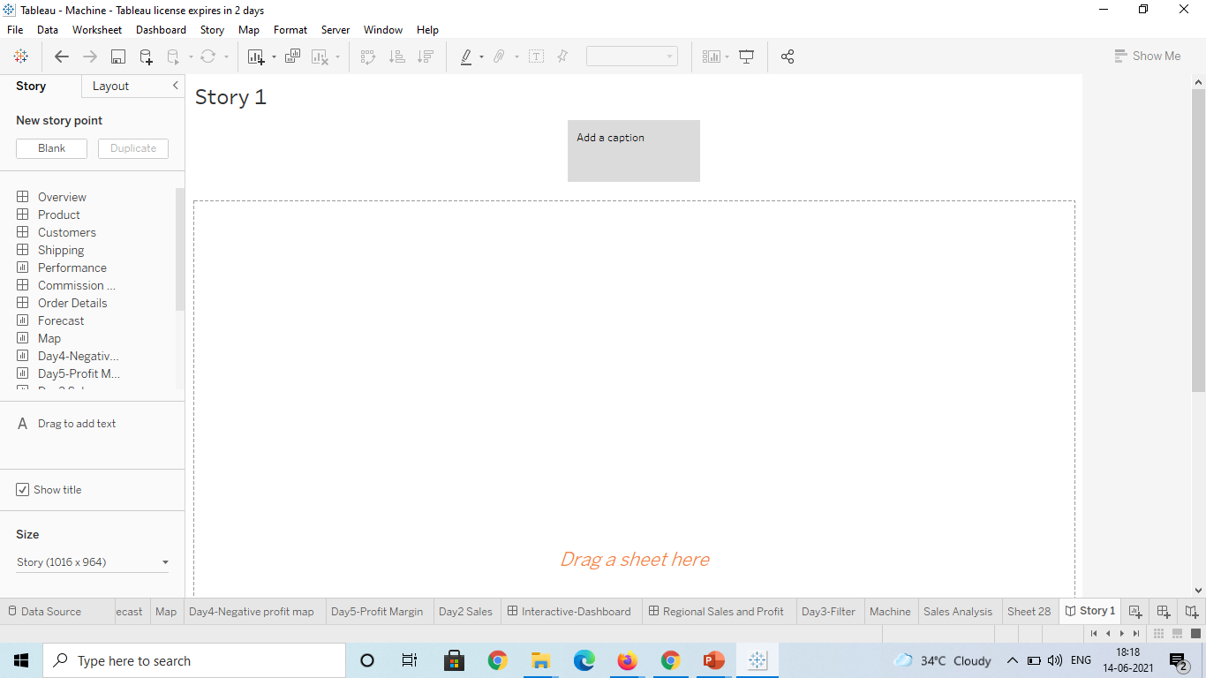
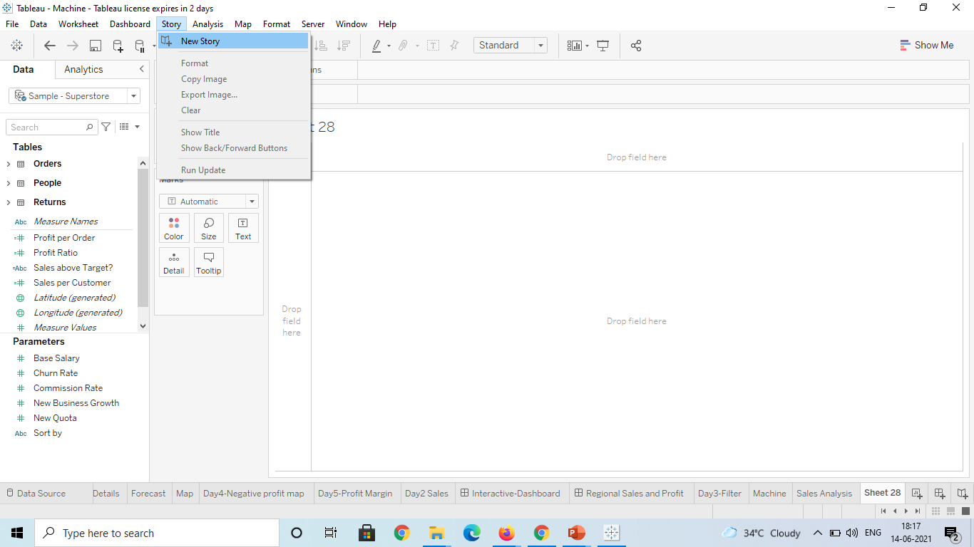
1. Create a story to present all your insights to your team.

Slide 4
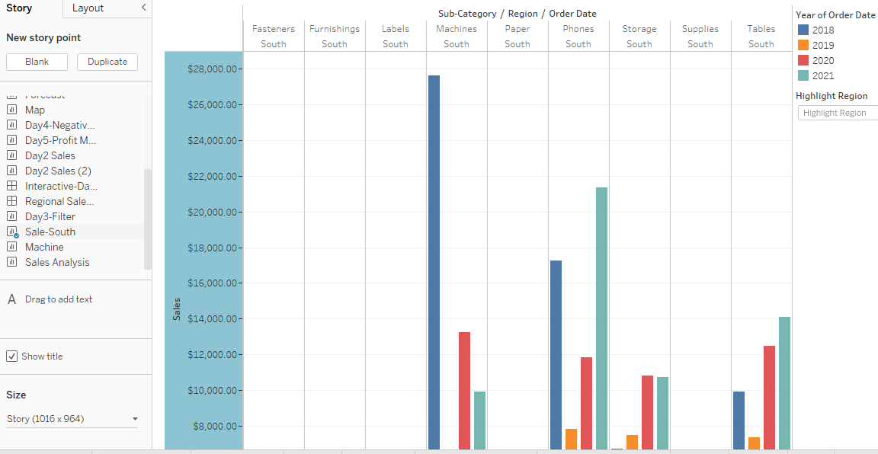
2. Show the sales in the south worksheet in your story.

Slide 5
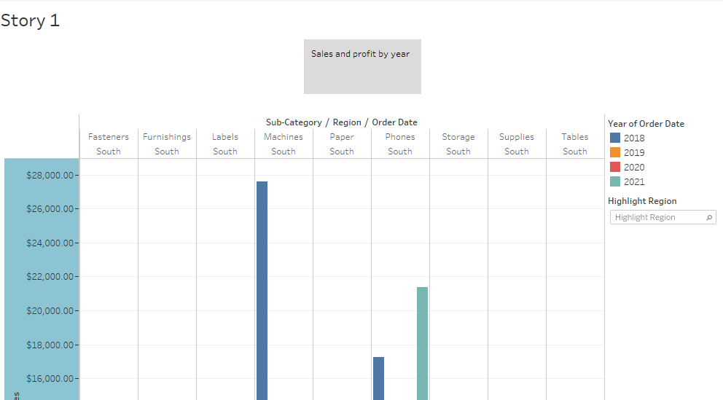

3. Add a caption ‘Sales and profit by year’ to the above story

Slide 6
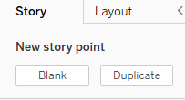
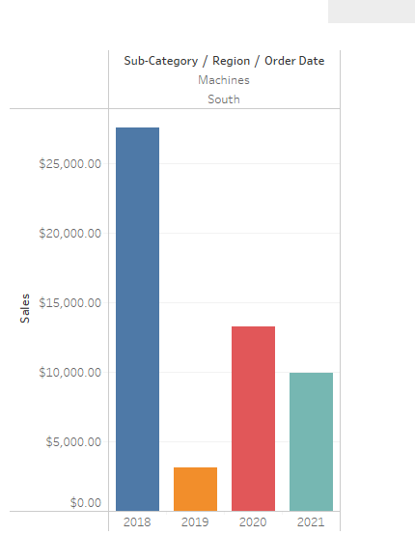
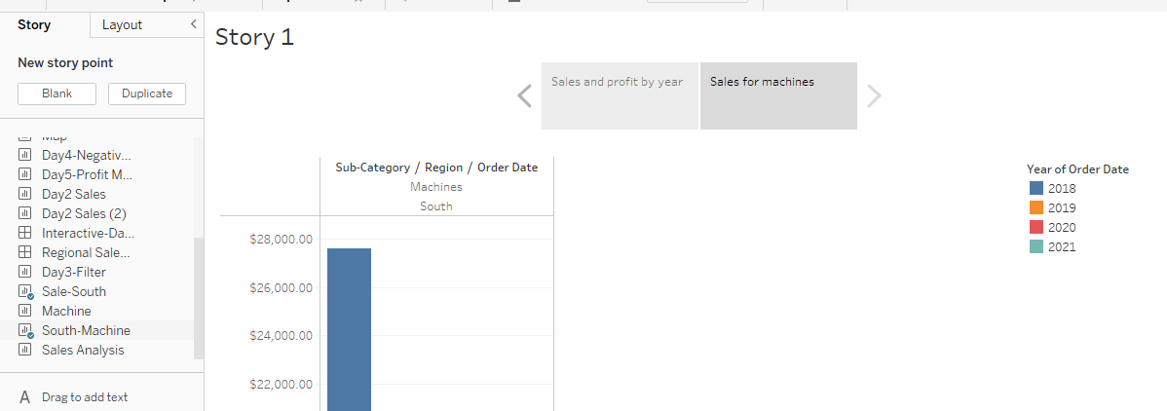
4. Duplicate the first caption and show sales and show the story of Sales for machine type subcategory.

Slide 7
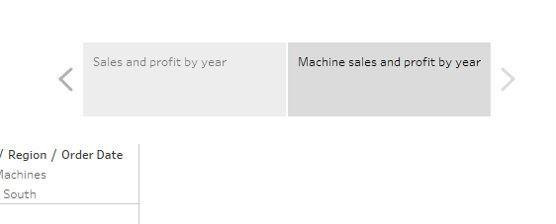
5. Add a caption ‘"Machine sales and profit by year" for Machine type subcategory

Slide 8
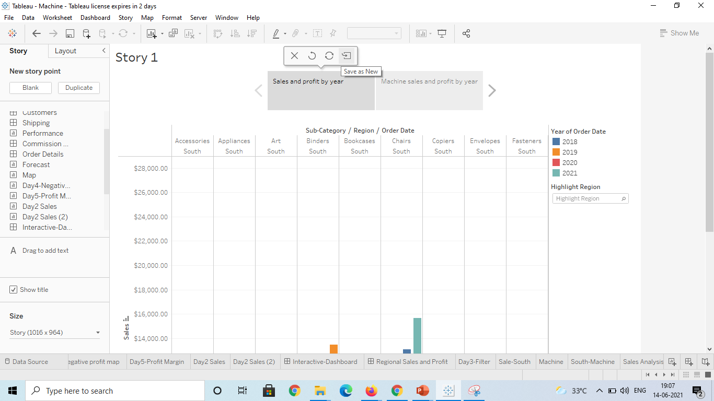
6. Check your Story mini toolbar around the story point caption

Slide 9
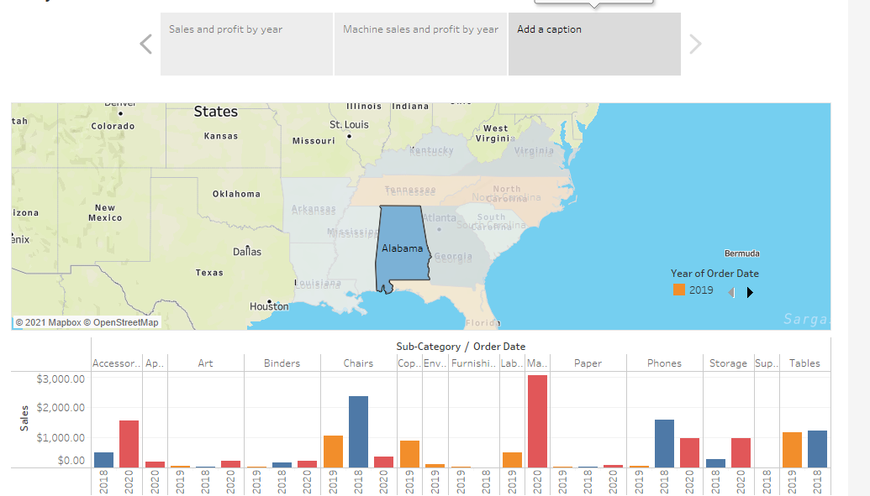
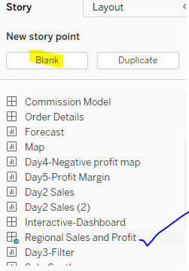
7. select Blank in the Story pane then, drag your dashboard Regional Sales and Profit onto the canvas and find some meaningful insights

Slide 10
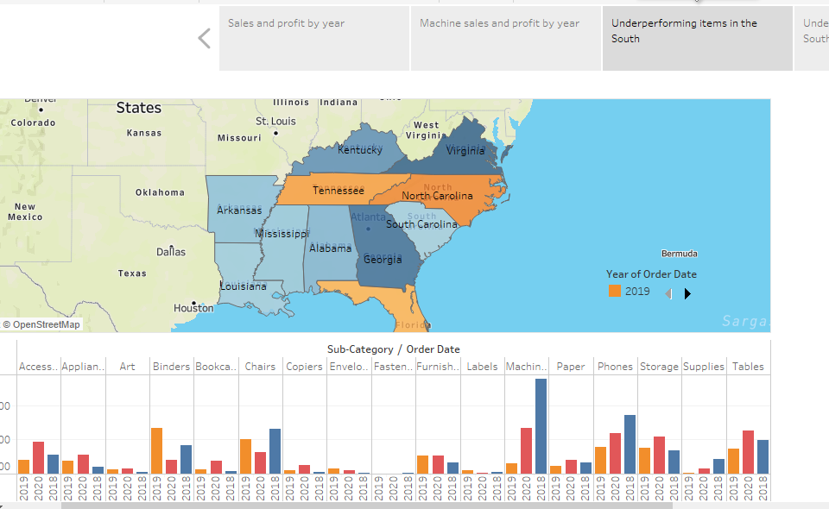

8. Add a caption "Underperforming items in the South“ in the above story point.

Slide 11
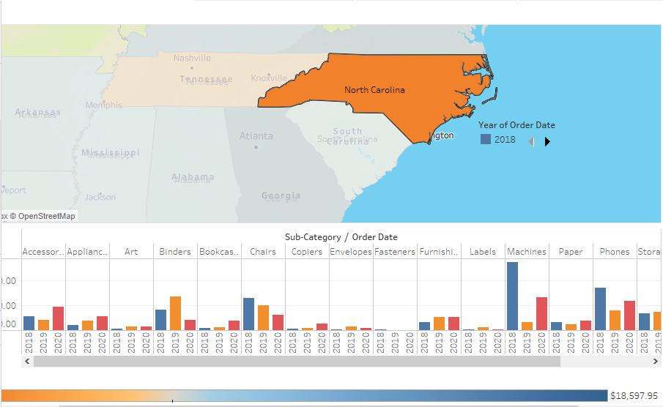
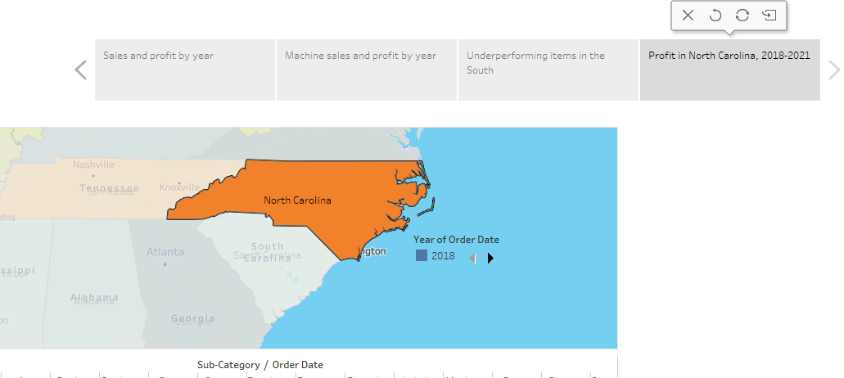
9. Duplicate the above story point and show your result only for north calorina and all the year.

Slide 12
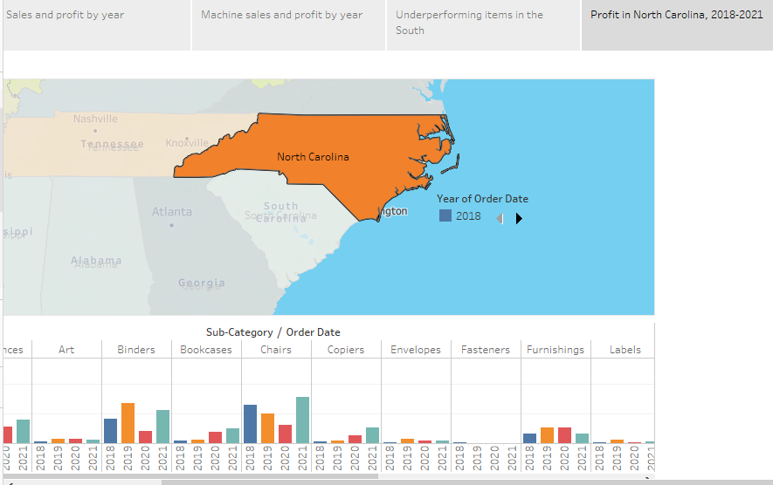
10. Add a caption ‘Profit in North Carolina, 2018-2021’ to the above story point

Slide 13
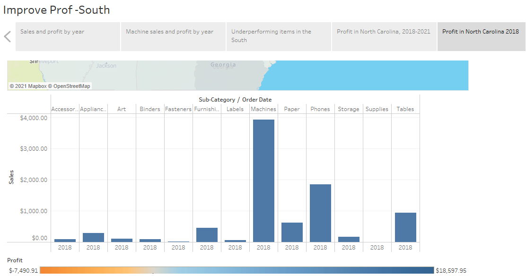
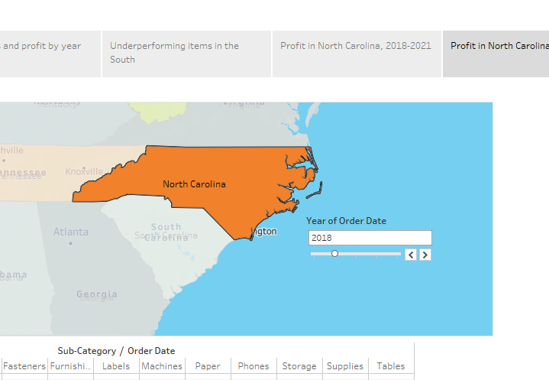
11. Duplicate the above story point and Show the profit in the North calrolina for 2018 and add a caption ‘Profit in North Carolina, 2018’.

Slide 14
12. Similarly show the profit for North Calorina for every year and add the caption.

Slide 15
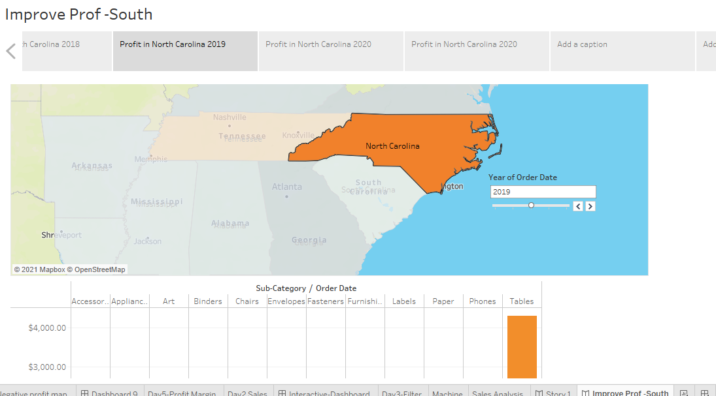
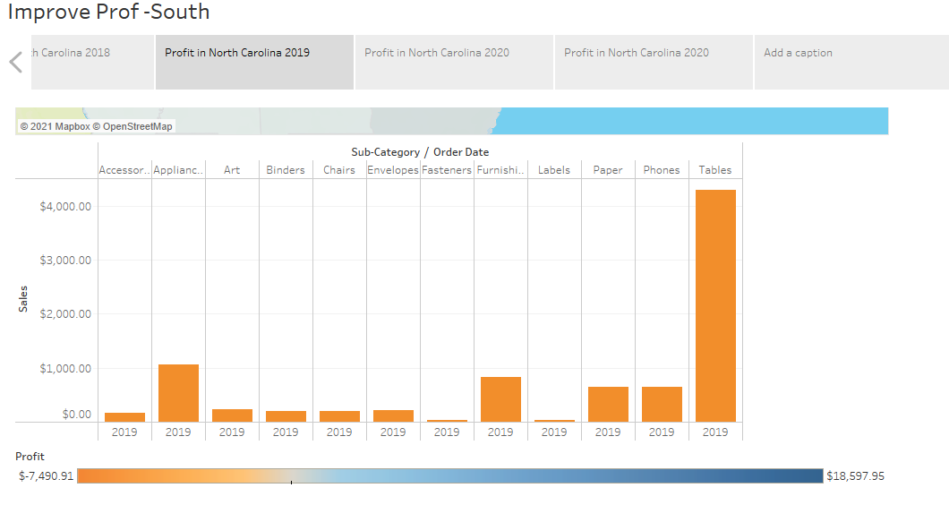
Profit in North Carolina, 2019

Slide 16
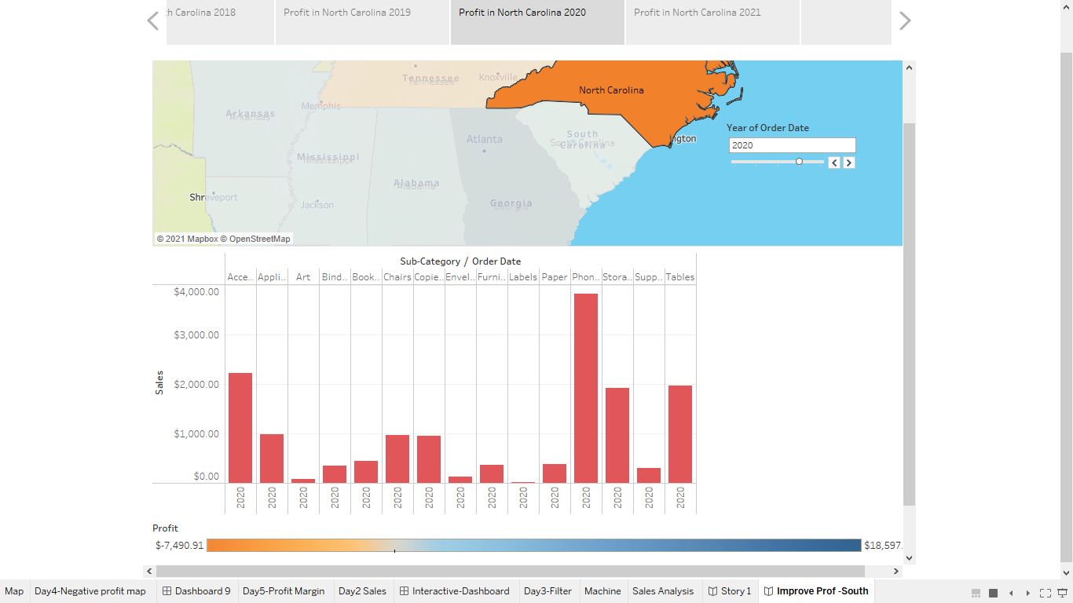
Profit in North Carolina, 2020

Slide 17
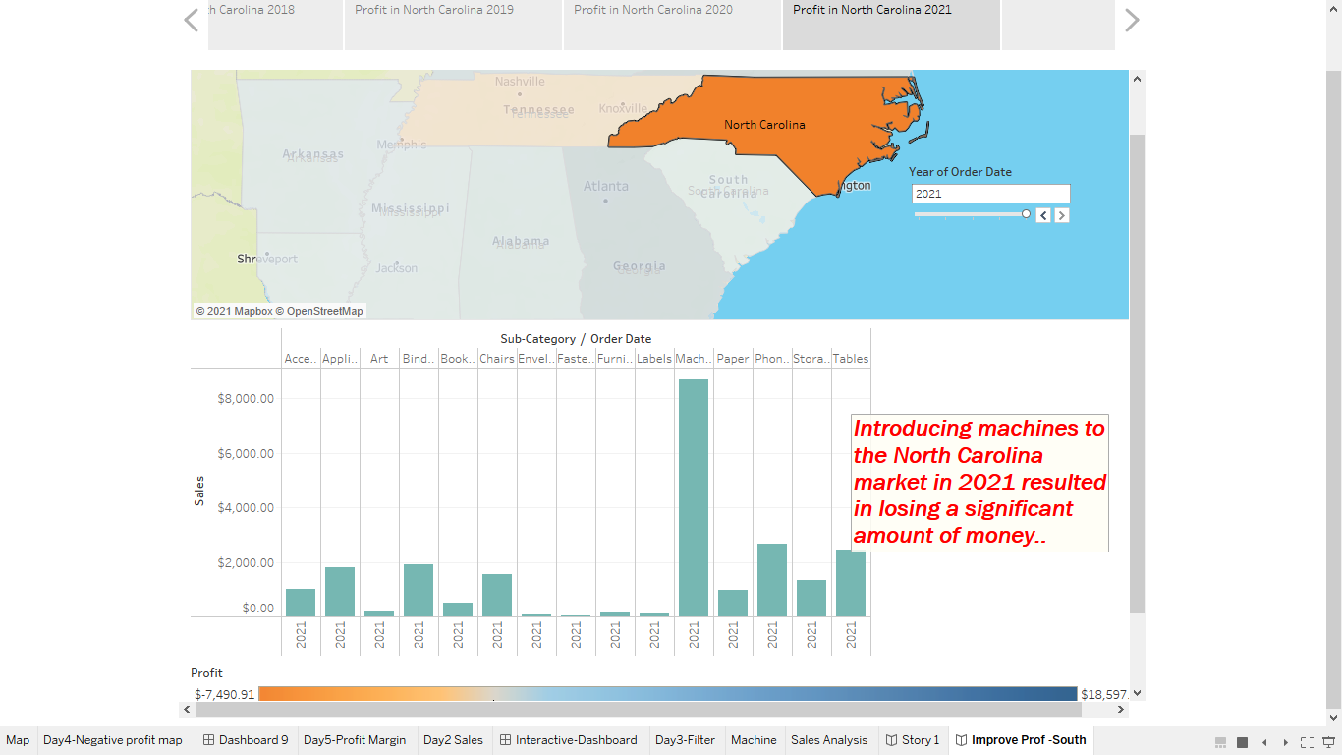
Profit in North Carolina, 2021
13. Select Drag to add text , drag it onto your view and enter the Description for your dashboard and enter a description for your dashboard ‘Introducing machines to the North Carolina market in 2021 resulted in losing a significant amount of money.’

Slide 18
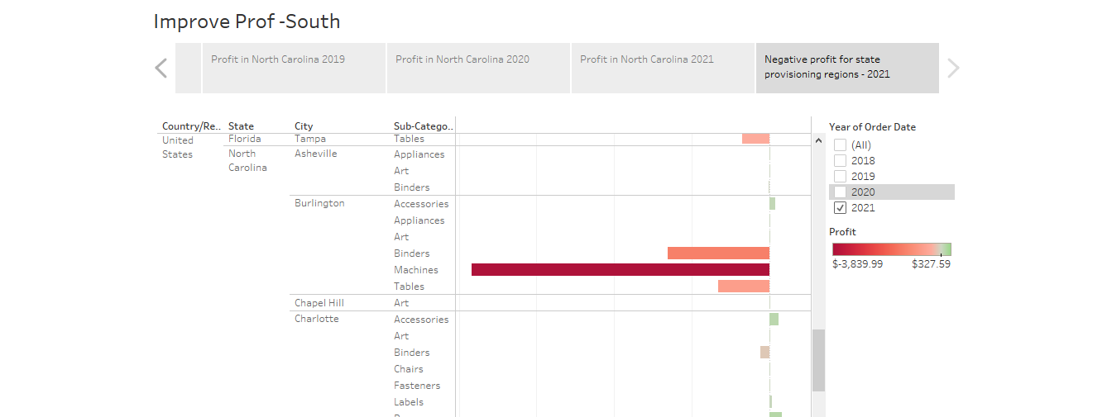
14. From the Story pane, click Blank and drag Negative Profit Bar Chart to the view and filter for 2021 year

Slide 19
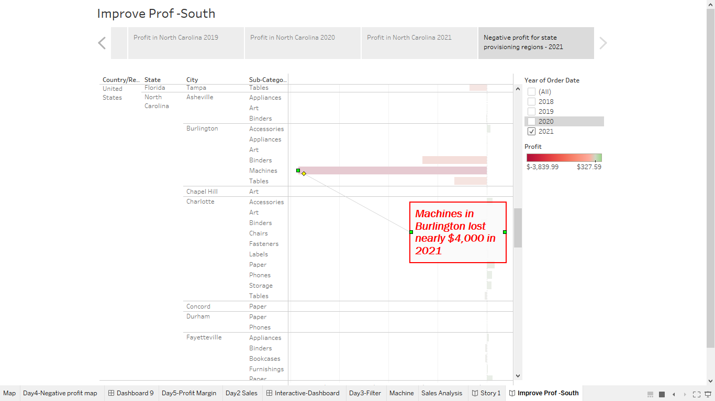
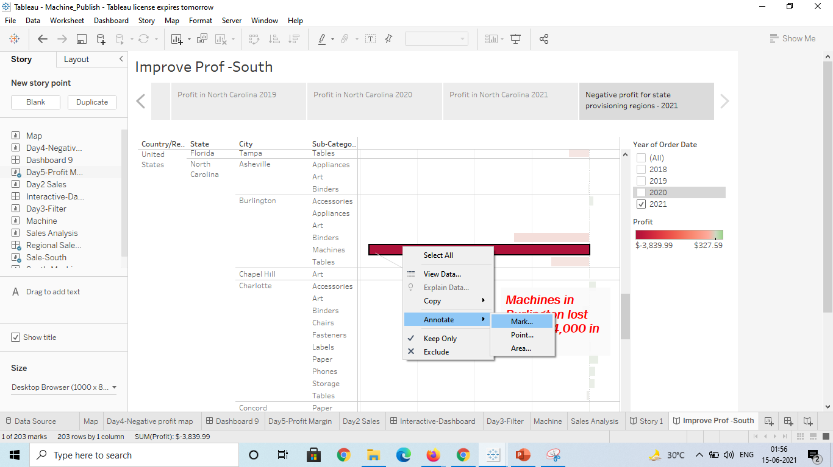
15. right-click the Burlington mark (the bar) and select Annotate > Mark. In the Edit Annotation dialog box that appears, delete the filler text and type: "Machines in Burlington lost nearly $4,000 in 2021."

Slide 20
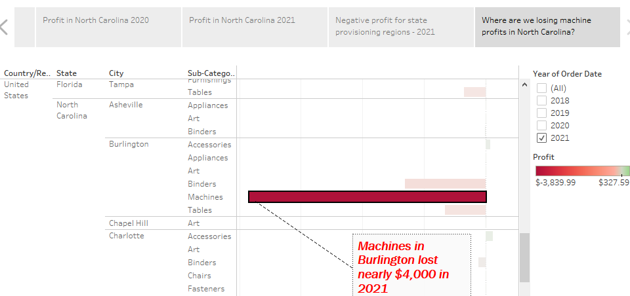
16. Add a caption "Where are we losing machine profits in North Carolina?“ to above story point.

Slide 21
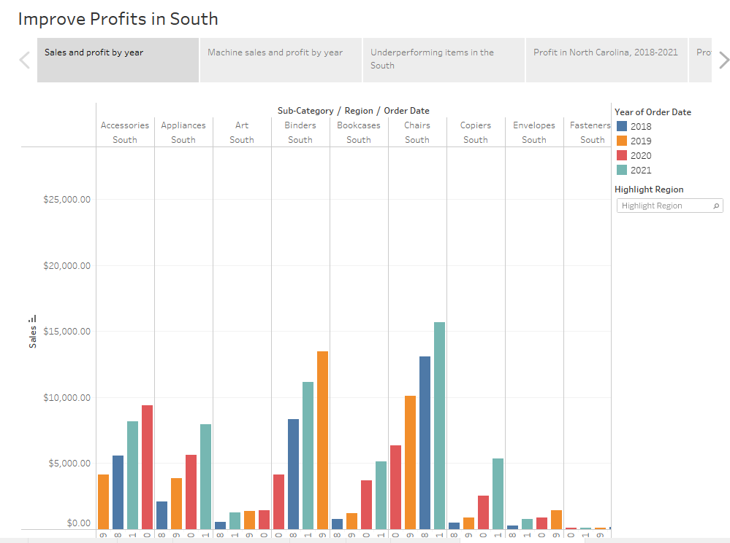
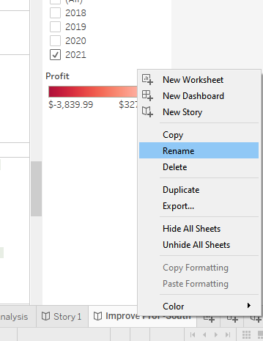
17. Rename your story as "Improve Profits in the South“ and check in the presentation mode.

